Slide 1

CALIFORNIA STATE UNIVERSITY, SACRAMENTO
PRESENTATION
on
RESEARCH PAPER AND PROJECT PROPOSAL
Presented by
DEVESH BINJOLA
NICHOLAS HANKS
Under the Guidance of
Dr. Meiliu Lu
Dept of Engineering And Computer Science

Slide 2
A RESEARCH PAPER ON
Mining Game Statistics from Web Services: A World of Warcraft Armory case study
Chris Lewis - PhD, Computer Science
Noah Wardrip-Fruin - Professor of Computer Science
University of California, Santa Cruz

Slide 3
ABSTRACT
Collecting quantitative data sets from publicly available "web services" (in this case, the WoW Armory website) and mining the data for qualitative study
This study analyzed the following:
(1) the ability of the constructed classifier to accurately predict character class based on equipment
(2) the correlation between the time it takes players to reach the maximum level (80) and their chosen character class
(3) the correlation between the number of deaths of a character and its class
(4) the most popular items equipped among the sample

Slide 4
Process and Results
To gather data, develop and implement a web crawler (WoWSpyder) to crawl WoW Armory website and download character data into database
Filter out characters with errors (detected through “impossible” stats, such as negative deaths)
Total sample size: 136,047 characters from the US and European servers

Slide 5
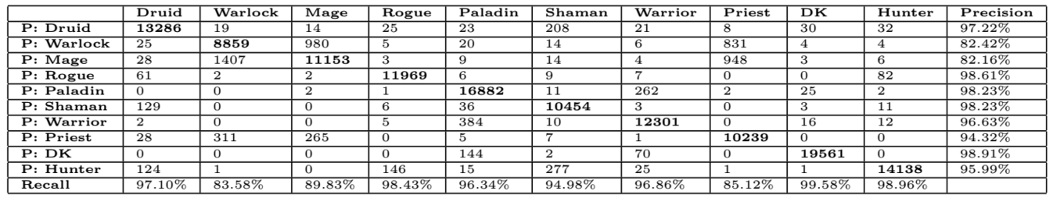
Process and Results
Naive Bayes classifier, 10-fold cross validation - 94.70% accuracy
Confusion Matrix
Purpose: discover deviations from designed “norms” in character equipment (class-targeted equipment)

Slide 6
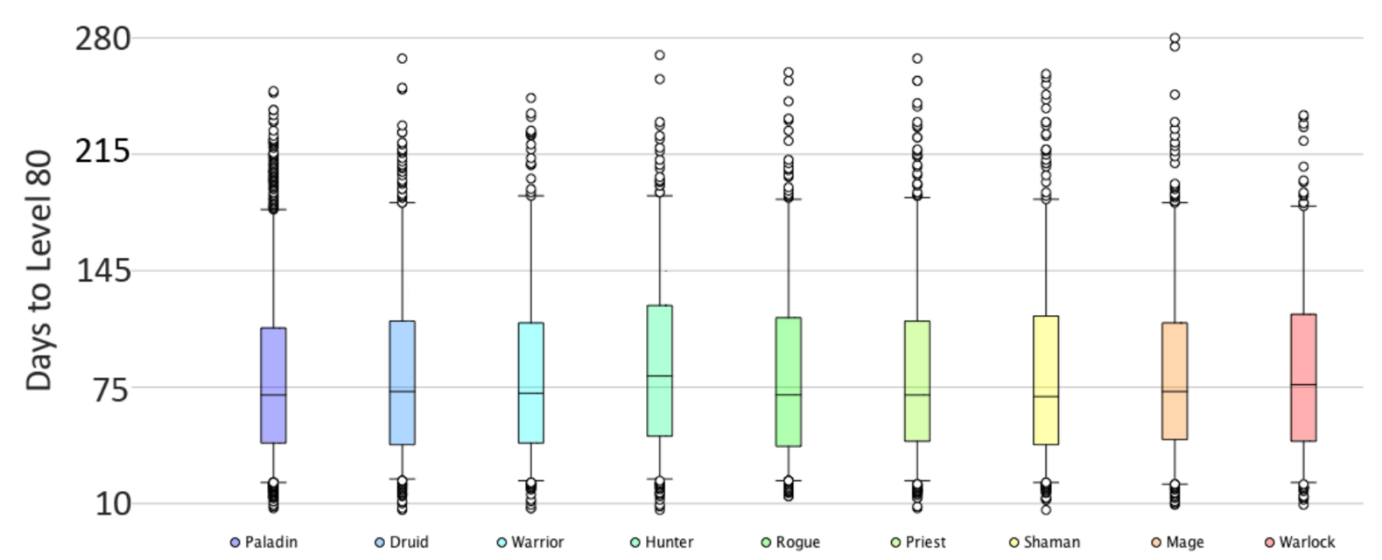
Process and Results
Calculate time to reach maximum level (80) from level 10 for each character
Construct box plot - Time (days) to Level 80 vs. Class
Analysis suggests there is no significant advantage/disadvantage among character classes

Slide 7
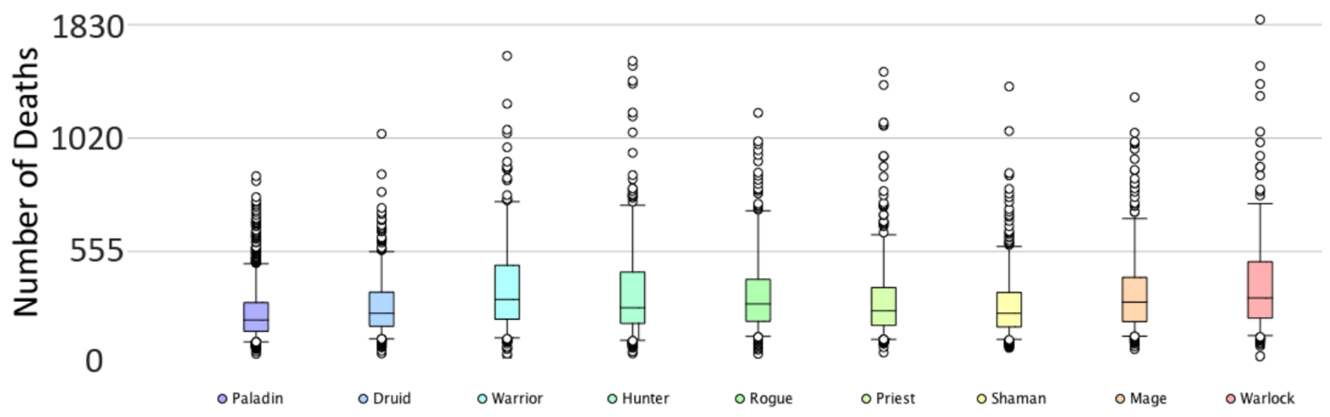
Process and Results
Construct box plot - Number of Deaths vs. Class
Analysis suggests there is imbalance among character classes

Slide 8
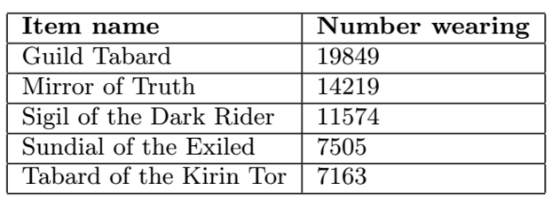
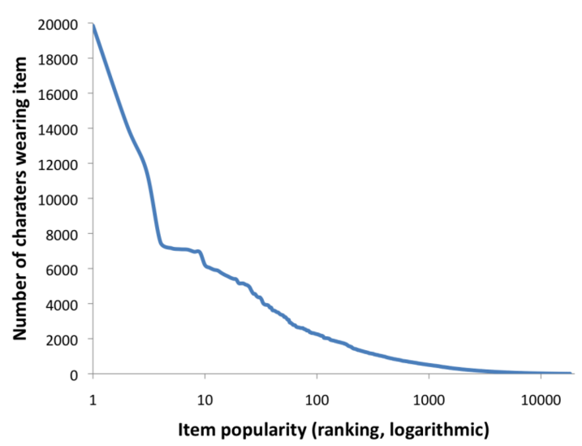
Process and Results
Construct list of most popular items (top 5 shown)
Graph Item Popularity vs. Number Wearing
Analysis suggests there is a trade-off between item power and rarity

Slide 9
Limitations
Web service query processing limitations (crawler restrictions)
Workaround: multiple threads, built-in delays and error handling
Financial limitations ($ no funding $)
Technological limitations (1 machine collecting data)
Data limitations (limited sample size, breadth of character data)
Trimmed data records, focus on pertinent attributes

Slide 10
OPINION ON RESEARCH PAPER
A good study on how to gather and mine video game data from widely available web services. Video game player data can be difficult to obtain for casual researchers and those without industry connections. Given adequate resources, this study could be scaled to handle a larger volume of data, as well as more investment into discovering other problems that could be solved using data mining techniques.

Slide 11


DATA MINING PROJECT PROPOSAL
“STOCK MARKET PREDICTION USING DATA MINING”
PROJECT TEAM :
DEVESH BINJOLA
NICHOLAS HANKS

Slide 12
OBJECTIVE
The goal of this data mining project is to predict the behavior of the stock market and to trace out the trend such as high price, low price, volume etc. To understand these large data sets we make use of clustering algorithms.
The algorithm used here is K-means. This project’s aim is to find the best cluster since cluster points change whenever the application is executed. This is done by using the multiple random normalizations where it chooses the best initial clusters.

Slide 13
SCHEDULE
Total working of data mining may take up to a week. The tentative schedule would be like as follows.
1.Stock data collection – 2 days
2.Implementing the algorithm – 2 days
3.Analysis – 2 days

Slide 14
ALGORITHM USED
The algorithm used here is K-means. This project’s aim is to find the best cluster since cluster points change whenever the application is executed. This is done by using the multiple random normalizations where it chooses the best initial clusters.

Slide 15
DATA WAREHOUSING Project Proposal
“DATAMART FOR GOLF DATABASE ”
PROJECT TEAM :
DEVESH BINJOLA
NICHOLAS HANKS

Slide 16
OBJECTIVE
Main objective of this data warehousing project is to implement data mart which can help in searching the golf history from its beginning to till date(men’s golf history).
This data mart can help to provide answers for the queries based on the database which are derived from the golf dataset:
The queries we are planning to implementing are:
Winner of majors by year
Count of majors by player name
Count of majors by major name
Winner of majors by major name

Slide 17
SCHEDULE
Total working of data ware housing may take upto 2 weeks. The tentative schedule would be like as follows.
golf data collection – 5 days
Data cleaning and preprocessing – 4 days
Implementation using PHP, MySQL – 5 days

Slide 18
REFERENCES
WIKIPEDIA
http://www.databasegolf.com/

